Slide 1
Elementary Rules of Usage

Slide 2
Rule 1:
The apostrophe ( ’ ) has three uses: contractions, plurals, and possessives.
The general rule is that the possessive of a singular noun is formed by adding an apostrophe and s, whether the singular noun ends in s or not.
the lawyer’s fee , the child’s toy, Xerox’s sales manager, anyone’s guess, a week's vacation, The witch‘s malice （怨恨）
Rule 1a. Many common nouns end in the letter s (lens, cactus, bus, etc.). So do a lot of proper nouns (Mr. Jones, Texas, Christmas). There are conflicting policies and theories about how to show possession when writing such nouns. There is no right answer; the best advice is to choose a formula and stay consistent. We will stick to Strunk & White rule
Tom Jones’s first album, Aeschylus’s finest drama, Charles's friend, Burns's poems
the class's hours, Mr. Jones’s golf clubs, the canvas's size, Texas’s weather
Didier Deschamps's career, Josquin des Prez's music, Eugène Delacroix's paintings
Exceptions are the possessives of ancient proper names
Jesus’ disciples , Moses' law
Nouns that end in an s sound take only an apostrophe when they are followed by sake.
conscience' sake, for righteousness' sake .

Slide 3
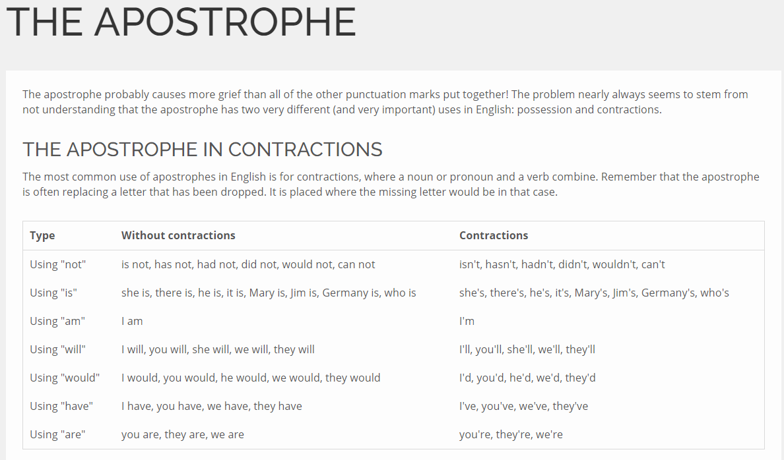

Slide 4
Rule 1
The pronominal possessives hers, its, theirs, yours , and ours have no apostrophe.
There was a big group of a dozen people at the table next to theirs
My book is here but hers is there.
My book is here but her book is there.
Indefinite pronouns, however, use the apostrophe to show possession.
one's rights
somebody else's umbrella

Slide 5
Rule 2:
Use a comma before any coordinating conjunction (and, but, for, or, nor, so, yet) that links two independent clauses.
red, white, and blue gold, silver, or copper
He opened the letter, read it, and made a note of its contents.
Use a comma after a dependent clause that starts a sentence.
My youngest niece, who lives in Ann Arbor, is a magazine editor.
When I went running, I saw a lion.
A mallard, the kind of duck I saw when I went running, attacked me.
I saw a duck, a magician, and a liquor store when I went running.
Finally, I went running.
Unsurprisingly, I saw a duck when I went running.
The duck that attacked me scared my friend. (Not Required)

Slide 6
Rule 3: Enclose parenthetic expressions between commas
A parenthetic expression （插入句） is a word, phrase, or clause added to a sentence without changing the meaning or grammar of the original sentence. Parenthetical expressions give extra information but are not essential
The police, hoping to save time, took the expressway
The best way to see a country, unless you are pressed for time, is to travel on foot.
Missing a comma is indefensible.
Marjorie’s husband, Colonel Nelson paid us a visit yesterday.
My brother you will be pleased to hear, is now in perfect health.

Slide 7
Rule 3:
A name or a title in direct address is parenthetic.
If, Sir, you refuse, I cannot predict what will happen.
Well, Susan, this is a fine mess you are in.
The abbreviations etc. , i.e ., and e.g ., the abbreviations for academic degrees, and titles that follow a name are parenthetic and should be punctuated accordingly.
Letters, packages, etc., should go here.
Horace Fulsome, Ph.D., presided.
Rachel Simonds, Attorney
The Reverend Harry Lang, S.J.

Slide 8
Rule 3:
No comma, however, should separate a noun from a restrictive term of identification.
Billy the Kid
The novelist Jane Austen
William the Conqueror
The poet Sappho
Although Junior , with its abbreviation Jr ., has commonly been regarded as parenthetic, logic suggests that it is, in fact, restrictive and therefore not in need of a comma.
James Wright Jr.

Slide 9
Rule 3:
Nonrestrictive (non essential) relative clauses are parenthetic.
The audience, which had at first been indifferent, became more and more interested.
In 1769, when Napoleon was born, Corsica had but recently been acquired by France.
Nether Stowey, where Coleridge wrote The Rime of the Ancient Mariner , is a few miles from Bridgewater.
Restrictive clauses, by contrast, are not parenthetic and are not set off by commas.
People who live in glass houses shouldn't throw stones.

Slide 10
Rule 3:
The same principle of comma use applies to participial phrases and to appositives.
People sitting in the rear couldn't hear, (restrictive)
Uncle Bert, being slightly deaf, moved forward, (non-restrictive )
My cousin Bob is a talented harpist, (restrictive )
Our oldest daughter, Mary, sings, (nonrestrictive)
When the main clause of a sentence is preceded by a phrase or a subordinate clause, use a comma to set off these elements.
Partly by hard fighting, partly by diplomatic skill, they enlarged their dominions to the east and rose to royal rank with the possession of Sicily.

Slide 11
Rule 4: Place a comma before a conjunction introducing an independent clause.
The early records of the city have disappeared, and the story of its first years can no longer be reconstructed.
The situation is perilous, but there is still one chance of escape.

Slide 12
Rule 4:
Two-part sentences of which the second member is introduced by as (in the sense of "because"), for, or, nor , or while (in the sense of "and at the same time") likewise require a comma before the conjunction.
If a dependent clause, or an introductory phrase requiring to be set off by a comma, precedes the second independent clause, no comma is needed after the conjunction.
The situation is perilous, but if we are prepared to act promptly, there is still one chance of escape.

Slide 13
Rule 4:
When the subject is the same for both clauses and is expressed only once, a comma is useful if the connective is but . When the connective is and , the comma should be omitted if the relation between the two statements is close or immediate.
I have heard the arguments, but am still unconvinced.
He has had several years' experience and is thoroughly competent.

Slide 14
Rule 5: Do not join independent clauses with a comma
If two or more clauses grammatically complete and not joined by a conjunction are to form a single compound sentence, the proper mark of punctuation is a semicolon.
Mary Shelley's works are entertaining; they are full of engaging ideas.
It is nearly half past five; we cannot reach town before dark.
It is, of course, equally correct to write each of these as two sentences, replacing the semicolons with periods.
Mary Shelley's works are entertaining. They are full of engaging ideas.
It is nearly half past five. We cannot reach town before dark.

Slide 15
Rule 5:
If a conjunction is inserted, the proper mark is a comma. (Rule 4.)
Mary Shelley's works are entertaining, for they are full of engaging ideas.
It is nearly half past five, and we cannot reach town before dark.

Slide 16
Rule 5:
If the second clause is preceded by an adverb, such as accordingly, besides, then, therefore , or thus , and not by a conjunction, the semicolon is still required.
I had never been in the place before; besides, it was dark as a tomb.
A comma is preferable when the clauses are very short and alike in form, or when the tone of the sentence is easy and conversational.
Man proposes, God disposes.
The gates swung apart, the bridge fell, the portcullis was drawn up.
I hardly knew him, he was so changed.
Here today, gone tomorrow.

Slide 17
Rule 6: Do not break sentences in two.
In other words, do not use periods for commas.
I met them on a Cunard liner many years ago. Coming home from Liverpool to New York.
She was an interesting talker. a woman who had traveled all over the world and lived in half a dozen countries.

Slide 18
Rule 7: Use a colon after an independent clause to introduce a list of particulars, an appositive, an amplification, or an illustrative quotation.
Your dedicated whittler requires three props: a knife, a piece of wood, and a back porch.
Understanding is that penetrating quality of knowledge that grows from theory, practice, conviction, assertion, error, and humiliation.
Wrong sentences
Your dedicated whittler requires: a knife, a piece of wood, and a back porch.
Understanding is that penetrating quality of knowledge that grows from: theory, practice, conviction, assertion, error, and humiliation.

Slide 19
Rule 7:
Join two independent clauses with a colon if the second interprets or amplifies the first.
But even so, there was a directness and dispatch about animal burial: there was no stopover in the undertaker's foul parlor, no wreath or spray.
A colon may introduce a quotation that supports or contributes to the preceding clause.
The squalor of the streets reminded her of a line from Oscar Wilde: "We are all in the gutter, but some of us are looking at the stars."

Slide 20
Rule 7
Other colon usage
the salutation of a formal letter
Dear Mr. Li:
notation of time
Departs at 10:48 P.M.
separate the title of a work from its subtitle
Data Mining: Algorithms and Applications

Slide 21
Rule 8: Use a dash to set off an abrupt break or interruption and to announce a long appositive or summary.
Em dash : The em dash is perhaps the most versatile punctuation mark. Depending on the context, the em dash can take the place of commas, parentheses, or colons—in each case to slightly different effect.
Notwithstanding its versatility, the em dash is best limited to two appearances per sentence. Otherwise, confusion rather than clarity is likely to result.
A dash is a mark of separation stronger than a comma, less formal than a colon, and more relaxed than parentheses.
His first thought on getting out of bed — if he had any thought at all — was to get back in again.
The rear axle began to make a noise — a grinding, chattering, teeth-gritting rasp.

Slide 22
Rule 8: Em dashes in place of commas
Do not mistake the em dash (—) for the slightly narrower en dash (–) or the even narrower hyphen (-).
Those marks serve different purposes and are further explained later in other sections.
Em dashes in place of commas
A pair of em dashes can be used in place of commas to enhance readability. Note, however, that dashes are always more emphatic than commas.
And yet, when the car was finally delivered—nearly three months after it was ordered—she decided she no longer wanted it, leaving the dealer with an oddly equipped car that would be difficult to sell.

Slide 23
Rule 8: Em dashes in place of parentheses
A pair of em dashes can replace a pair of parentheses.
Dashes are considered less formal than parentheses; they are also more intrusive. If you want to draw attention to the parenthetical content, use dashes. If you want to include the parenthetical content more subtly, use parentheses.
Note that when dashes are used in place of parentheses, surrounding punctuation should be omitted.
Compare the following examples.
Upon discovering the errors (all 124 of them), the publisher immediately recalled the books.
Upon discovering the errors—all 124 of them—the publisher immediately recalled the books.
When used in place of parentheses at the end of a sentence, only a single dash is used.
After three weeks on set, the cast was fed up with his direction (or, rather, lack of direction).
After three weeks on set, the cast was fed up with his direction—or, rather, lack of direction.

Slide 24
Rule 8: The em dash in place of a colon
The em dash can be used in place of a colon when you want to emphasize the conclusion of your sentence.
The dash is less formal than the colon.
After months of deliberation, the jurors reached a unanimous verdict—guilty.
The white sand, the warm water, the sparkling sun—this is what brought them to Hawaii.

Slide 25
Rule 8: Multiple em dashes — —
Two em dashes can be used to indicate missing portions of a word, whether unknown or intentionally omitted.
Mr. J— — testified that the defendant yelled, “Die, a— —,” before pulling the trigger.
From the faded and water-damaged note, we made out only this: “Was ne— —y going to m— — K— —, but now — —t.”
When an entire word is missing, either two or three em dashes can be used. Whichever length you choose, use it consistently throughout your document. Surrounding punctuation should be placed as usual.
The juvenile defendant, — — —, was arraigned yesterday.

Slide 26
Rule 8: Spaces with the em dash
The em dash is typically used without spaces on either side, and that is the style used in this guide.
Most newspapers, however, set the em dash off with a single space on each side.
Most newspapers — and all that follow AP* style — insert a space before and after the em dash.
Producing the em dash
Many modern word processors will automatically insert an em dash when you type a pair of hyphens. Otherwise, look for an “insert symbol” command. If you are using a typewriter, a pair of hyphens is the closest you can get to an em dash.
*The Associated Press Stylebook and Briefing on Media Law, usually called the AP Stylebook, is an English grammar style and usage guide created by American journalists working for or connected with the Associated Press over the last century to standardize mass communications.

Slide 27
Rule 8
Use a dash only when a more common mark of punctuation seems inadequate.
Her father's suspicions proved well-founded — it was not Edward she cared for — it was San Francisco.
Violence — the kind you see on television — is not honestly violent — there lies its harm.
Her father's suspicions proved well-founded. It was not Edward she cared for, it was San Francisco.
Violence, the kind you see on television, is not honestly violent. There lies its harm.

Slide 28
Singular or Plural Verb?
Basic Rule. A singular subject (she, Bill, car) takes a singular verb (is, goes, shines), whereas a plural subject takes a plural verb
One of the worst mistakes you can make in English is having the wrong verb form in the
third person singular and plural.
Remember: in the present tense in the third person (he, she, it and they)
Singular Subject ----> verb stem plus S, it fits, he sits, etc.
Plural subject ----> verb stem without s, they sit, they work, etc.
NB: The plural s on the end of the noun/subject has nothing to do with the s on the end of the verb.
Writing is instead of are (and was instead of were) or vice versa, is a serious mistake in
English grammar.
If you suspect that you have a tendency to make this kind of mistake, check each clause
and look for the subject and its associated verb.
Remember that the subject is not always the noun closest to the verb.
E.g. The concentration (singular subject) of Cs in 27 samples was (singular verb) determined.
Note: samples is not the subject!

Slide 29
Here are a few examples of tricky singulars and plurals.
* A number of (i.e. several) measurements have been made.
* The number (singular) of units has been reported to be 50.
* It appears that 30 g (plural) are required daily.
* In some areas 60% (%=singular) of the workforce is unemployed.
* The most part (singular) of the compounds is inactive.
* A total (singular) of 32 measurements has been made.
The majority (i.e. most) of the tests were performed in Lund.
* Kinetics, dynamics, politics and other words ending in -ics and meaning "the study of..." usually take a singular verb.
E.g.
Acoustics is the study of the behavior of sound.
In other cases, they take a plural verb.
E.g.
The acoustics in this hall are terrible.

Slide 30
Neither, nor and none are treated as singular.
Neither the slope nor the magnitude was reproduced by the model.
Neither of the models was correct.
None of the fits to the data was adequate.
Other tricky cases
* The liquid, together with the vapour, returns to the chamber. Here the
subject of the clause is "the liquid" not "the liquid and the vapour".
It sometimes helps to rearrange the sentence if you're not sure which verb
form to use.
* The liquid returns to the chamber, together with the vapour.
OR
* The liquid and the vapour return to the chamber. (Not as interesting but
it says what you mean.)

Slide 31
Rule 9: The number of the subject determines the number of the verb.
Subject-Verb Agreement
Words that intervene between subject and verb do not affect the number of the verb.
Incorrect:
The bittersweet flavor of youth — its trials, its joys, its adventures, its challenges — are not soon forgotten.
Correct:
The bittersweet flavor of youth — its trials, its joys, its adventures, its challenges — is not soon forgotten.

Slide 32
Rule 9
A common blunder is the use of a singular verb form in a relative clause following "one of..." or a similar expression when the relative is the subject.
Incorrect
One of the ablest scientists who has attacked this problem
One of those people who is never ready on time
Correct
One of the ablest scientists who have attacked this problem
One of those people who are never ready on time

Slide 33
Rule 9
Use a singular verb form after each, either, everyone, everybody, neither, nobody, someone.
Everybody thinks he has a unique sense of humor.
Although both clocks strike cheerfully, neither keeps good time.
With none , use the singular verb when the word means "no one" or "not one.“
Incorrect: None of us are perfect.
Correct: None of us is perfect.

Slide 34
Rule 9
A plural verb is commonly used when none suggests more than one thing or person.
None are so fallible as those who are sure they're right.
A compound subject formed of two or more nouns joined by and almost always requires a plural verb.
The walrus and the carpenter were walking close at hand.

Slide 35
Rule 9
But certain compounds, often clichés, are so inseparable they are considered a unit and so take a singular verb, as do compound subjects qualified by each or every.
The long and the short of it is ...
Bread and butter was all she served.
Give and take is essential to a happy household.
Every window, picture, and mirror was smashed.

Slide 36
Rule 9
A singular subject remains singular even if other nouns are connected to it by with, as well as, in addition to, except, together with , and no less than.
His speech as well as his manner is objectionable.
A linking verb agrees with the number of its subject.
What is wanted is a few more pairs of hands.
The trouble with truth is its many varieties.
The only sign of Christmas was the stockings on the mantel.

Slide 37
Rule 9
Some nouns that appear to be plural are usually construed as singular and given a singular verb.
Politics is an art, not a science.
The Republican Headquarters is on this side of the tracks.
Nouns that look like plurals, because they end in -s, but whose meaning is collective or composite, are known as ‘pluralia tantum’. Headquarters is one such, and premises, surroundings and outskirts are others
But
The general's quarters are across the river.
In these cases the writer must simply learn the idioms.
The contents of a book is singular.
The contents of a jar may be either singular or plural, depending on what's in the jar — jam or marbles.

Slide 38
Rule 10: Use the proper case of pronoun
The personal pronouns, as well as the pronoun who , change form as they function as subject or object.
Will Jane or he be hired, do you think?
The culprit, it turned out, was he.
We heavy eaters would rather walk than ride.
Who knocks?
Give this work to whoever looks idle.

Slide 39
Rule 10
When who introduces a subordinate clause, its case depends on its function in that clause.
Incorrect
Virgil Soames is the candidate whom we think will win.
Virgil Soames is the candidate who we hope to elect.
Correct
Virgil Soames is the candidate who we think will win. [We think he will win.]
Virgil Soames is the candidate whom we hope to elect. [We hope to elect him.]
try substituting "her/him” and "she/he" and, depending on which one fits, use "whom“/”whomever” (for "him/her") and "who“ /“whoever” (for "he/She").

Slide 40
Who is your closest friend?
Whom do you bank with?
Who do you think will win the award?
Chip is the kind of person whom my parents warned me about.
Omar will talk about his girlfriend with whoever asks him.
Kimiko donates her time to whoever needs it most.
Quinton will work on the project with whomever you suggest.
I will support whomever we elect.
Kathy was not sure whom she was voting for.
Whoever wins the lottery will become a millionaire.

Slide 41
Rule 10
A pronoun in a comparison is nominative if it is the subject of a stated or understood verb.
Sandy writes better than I. (Than I write.)
In general, avoid "understood" verbs by supplying them.
I think Horace admires Jessica more than I.
Polly loves cake more than me.
I think Horace admires Jessica more than I do.
Polly loves cake more than she loves me.

Slide 42
Rule 10
The objective case is correct in the following examples.
The ranger offered Shirley and him some advice on campsites.
They came to meet the Baldwins and us.
Let's talk it over between us, then, you and me.
Whom should I ask?

Slide 43
Rule 10
Use the simple personal pronoun as a subject.
Incorrect
Blake and myself stayed home.
Howard and yourself brought the lunch, I thought.
Correct
Blake and I stayed home.
Howard and you brought the lunch, I thought.

Slide 44
Rule 10
The possessive case of pronouns is used to show ownership. It has two forms: the adjectival modifier, your hat, and the noun form, a hat of yours.
The dog has buried one of your gloves and one of mine in the flower bed.
Gerunds usually require the possessive case.
Mother objected to our driving on the icy roads.
A present participle as a verbal, on the other hand, takes the objective case.
They heard him singing in the shower.

Slide 45
Rule 10
The difference between a verbal participle and a gerund is not always obvious, but note what is really said in each of the following.
Do you mind me asking a question?
Do you mind my asking a question?
In the first sentence, the queried objection is to me , as opposed to other members of the group, asking a question.
In the second example, the issue is whether a question may be asked at all.

Slide 46
Rule 11: A participial phrase at the beginning of a sentence must refer to the grammatical subject.
Walking slowly down the road, he saw a woman accompanied by two children.
The word walking refers to the subject of the sentence ( “he”), not to the woman.
To make it refer to the woman, the writer must recast the sentence.
He saw a woman, accompanied by two children, walking slowly down the road.

Slide 47
Rule 11
Participial phrases preceded by a conjunction or by a preposition, nouns in apposition, adjectives, and adjective phrases come under the same rule if they begin the sentence.
On arriving in Chicago, his friends met him at the station.
A soldier of proved valor, they entrusted him with the defense of the city.
Young and inexperienced, the task seemed easy to me.
Without a friend to counsel him, the temptation proved irresistible.
On arriving in Chicago, he was met at the station by his friends.
A soldier of proved valor, he was entrusted with the defense of the city.
Young and inexperienced, I thought the task easy.
Without a friend to counsel him, he found the temptation irresistible.
At the age of ten, my father bought me a puppy. | When I was ten, my father bought me a puppy.

Slide 48
Rule 11
Sentences violating Rule 11 are often ludicrous:
Being in a dilapidated condition, I was able to buy the house very cheap.
Me, Being in a dilapidated condition, I was able to buy the house very cheap.
Wondering irresolutely what to do next, the clock struck twelve.
The clock was wondering irresolutely what to do next when it struck twelve.
Born at the age of forty-three, the baby was a great comfort to Mrs. Wooster.
Tail wagging merrily, Bertie took the dog for a walk.
On returning home, phone rang.
On Maxine returning home, her phone rang (better understood)

Slide 49
Elementary Principles of Composition

Slide 50
Rule 12: Choose a suitable design and hold to it
A basic structural design underlies every kind of writing. Writers will in part follow this design, in part deviate from it, according to their skills, their needs, and the unexpected events that accompany the act of composition.
Writing, to be effective, must follow closely the thoughts of the writer, but not necessarily in the order in which those thoughts occur. This calls for a scheme of procedure. In some cases, the best design is no design, as with a love letter, which is simply an outpouring, or with a casual essay, which is a ramble. But in most cases, planning must be a deliberate prelude to writing.
The first principle of composition, therefore, is to foresee or determine the shape of what is to come and pursue that shape.

Slide 51
Rule 12
Most forms of composition are less clearly defined, more flexible, but all have skeletons to which the writer will bring the flesh and the blood. The more clearly the writer perceives the shape, the better are the chances of success.

Slide 52
Rule 13: Make the paragraph the unit of composition
The paragraph is a convenient unit; it serves all forms of literary work. As long as it holds together, a paragraph may be of any length — a single, short sentence or a passage of great duration.
If the subject on which you are writing is of slight extent, or if you intend to treat it briefly, there may be no need to divide it into topics. Thus, a brief description, a brief book review, a brief account of a single incident, a narrative merely outlining an action, the setting forth of a single idea — any one of these is best written in a single paragraph.
After the paragraph has been written, examine it to see whether division will improve it.

Slide 53
Rule 13
Ordinarily, however, a subject requires division into topics, each of which should be dealt with in a paragraph.
The object of treating each topic in a paragraph by itself is, of course, to aid the reader.
The beginning of each paragraph is a signal that a new step in the development of the subject has been reached.
As a rule, single sentences should not be written or printed as paragraphs.
An exception may be made of sentences of transition, indicating the relation between the parts of an exposition or argument.

Slide 54
Rule 13
As a rule, begin each paragraph either with a sentence that suggests the topic or with a sentence that helps the transition.
If a paragraph forms part of a larger composition, its relation to what precedes, or its function as a part of the whole, may need to be expressed. This can sometimes be done by a mere word or phrase (again, therefore, for the same reason ) in the first sentence.
Sometimes, however, it is expedient to get into the topic slowly, by way of a sentence or two of introduction or transition.

Slide 55
Rule 13
In general, remember that paragraphing calls for a good eye as well as a logical mind. Enormous blocks of print look formidable to readers, who are often reluctant to tackle them.
Therefore, breaking long paragraphs in two, even if it is not necessary to do so for sense, meaning, or logical development, is often a visual help.
But remember, too, that firing off many short paragraphs in quick succession can be distracting.
Paragraph breaks used only for show read like the writing of commerce or of display advertising. Moderation and a sense of order should be the main considerations in paragraphing.

Slide 56
Rule 14: Use the active voice
The active voice is usually more direct and vigorous than the passive.
I shall always remember my first visit to Boston.
My first visit to Boston will always be remembered by me.
My first visit to Boston will always be remembered.

Slide 57
Rule 14
Many a tame sentence of description or exposition can be made lively and emphatic by substituting a transitive in the active voice for some such perfunctory expression as there is or could be heard.
There were a great number of dead leaves lying on the ground.
At dawn the crowing of a rooster could be heard.
The reason he left college was that his health became impaired.
It was not long before she was very sorry that she had said what she had.
Dead leaves covered the ground.
The cock's crow came with dawn.
Failing health compelled him to leave college.
She soon repented her words.
Note, in the examples above, that when a sentence is made stronger, it usually becomes shorter. Thus, brevity is a by-product of vigor.

Slide 58
Rule 15: Put statements in positive form
Make definite assertions.
Avoid tame, colorless, hesitating, noncommittal language.
Use the word not as a means of denial or in antithesis, never as a means of evasion.
He was not very often on time.
She did not think that studying Latin was a sensible way to use one's time.
The Taming of the Shrew is rather weak in spots. Shakespeare does not portray Katharine as a very admirable character, nor does Bianca remain long in memory as an important character in Shakespeare's works.
He usually came late.
She thought the study of Latin a waste of time.
The women in The Taming of the Shrew are unattractive. Katharine is disagreeable, Bianca insignificant.
All three examples show the weakness inherent in the word not . Consciously or unconsciously, the reader is dissatisfied with being told only what is not; the reader wishes to be told what is.

Slide 59
Rule 15
As a rule, it is better to express even a negative in positive form.
not honest
not important
did not remember
did not pay any attention to
did not have much confidence in
dishonest
trifling
forgot
ignored
distrusted

Slide 60
Rule 15
Placing negative and positive in opposition makes for a stronger structure.
Not charity, but simple justice.
Not that I loved Caesar less, but that I loved Rome more.
Ask not what your country can do for you — ask what you can do for your
country.

Slide 61
Rule 15
Statements qualified with unnecessary auxiliaries or conditionals sound irresolute.
If you would let us know the time of your arrival, we would be happy to arrange your transportation from the airport.
Applicants can make a good impression by being neat and punctual.
Plath may be ranked among those modem poets who died young.
If you will let us know the time of your arrival, we shall be happy to arrange your transportation from the airport.
Applicants will make a good impression if they are neat and punctual.
Plath was one of those modern poets who died young.
If your every sentence admits a doubt, your writing will lack authority. Save the auxiliaries would, should, could, may, might , and can for situations involving real uncertainty.

Slide 62
Rule 16: Use definite, specific, concrete language
Prefer the specific to the general, the definite to the vague, the concrete to the abstract.
A period of unfavorable weather set in.
He showed satisfaction as he took possession of his well-earned reward.
It rained every day for a week.
He grinned as he pocketed the coin.
In exposition and in argument, the writer must likewise never lose hold of the concrete; and even when dealing with general principles, the writer must furnish particular instances of their application.

Slide 63
Rule 17: Omit needless words
Vigorous writing is concise. A sentence should contain no unnecessary words, a paragraph no unnecessary sentences. This requires not that the writer make all sentences short, or avoid all detail and treat subjects only in outline, but that every word tell.
the question as to whether
there is no doubt but that
used for fuel purposes
he is a man who
in a hasty manner
this is a subject that
Her story is a strange one.
the reason why is that
whether (the question whether)
no doubt (doubtless)
used for fuel
he
hastily
this subject
Her story is strange.
because

Slide 64
Rule 17: Omit needless words
The fact that is an especially debilitating expression. It should be revised out of every sentence in which it occurs.
owing to the fact that
in spite of the fact that
call your attention to the fact that
I was unaware of the fact that
the fact that he had not succeeded
the fact that I had arrived
since (because)
though (although)
remind you (notify you)
I was unaware that (did not know)
his failure
my arrival
The words case, character, nature, who is, which was, and the like are often superfluous.
His cousin, who is a member of the same firm
Trafalgar, which was Nelson's last battle
His cousin, a member of the same firm
Trafalgar, Nelson's last battle

Slide 65
Rule 17: Omit needless words
As the active voice is more concise than the passive, and a positive statement more concise than a negative one.
A common way to fall into wordiness is to present a single complex idea, step by step, in a series of sentences that might to advantage be combined into one.
Macbeth was very ambitious. This led him
to wish to become king of Scotland. The
witches told him that this wish of his would
come true. The king of Scotland at this time
was Duncan. Encouraged by his wife,
Macbeth murdered Duncan. He was thus
enabled to succeed Duncan as king. (51
words)
Encouraged by his wife, Macbeth achieved
his ambition and realized the prediction of
the witches by murdering Duncan and
becoming king of Scotland in his place. (26
words)

Slide 66
Rule 18: Avoid a succession of loose sentences
This rule refers especially to loose sentences of a particular type:
those consisting of two clauses, the second introduced by a conjunction or relative.
A writer may err by making sentences too compact and periodic.
An occasional loose sentence prevents the style from becoming too formal and gives the reader a certain relief. Consequently, loose sentences are common in easy, unstudied writing.
The danger is that there may be too many of them.

Slide 67
Rule 18
An unskilled writer will sometimes construct a whole paragraph of sentences of this kind, using as connectives and, but , and, less frequently, who, which, when, where , and while , these last in nonrestrictive senses.

Slide 68
Rule 18
A bad example
The third concert of the subscription series was given last evening, and a large audience was in attendance. Mr. Edward Appleton was the soloist, and the Boston Symphony Orchestra furnished the instrumental music. The former showed himself to be an artist of the first rank, while the latter proved itself fully deserving of its high reputation. The interest aroused by the series has been very gratifying to the Committee, and it is planned to give a similar series annually hereafter. The fourth concert will be given on Tuesday, May 10, when an equally attractive program will be presented.
Apart from its triteness and emptiness, the paragraph above is bad because of the structure of its sentences, with their mechanical symmetry and singsong.

Slide 69
Rule 18
A good example from the chapter in "What I Believe" in E. M. Forster's Two Cheers for Democracy.
I believe in aristocracy, though — if that is the right word, and if a democrat may use it. Not an aristocracy of power, based upon rank and influence, but an aristocracy of the sensitive, the considerate and the plucky. Its members are to be found in all nations and classes, and all through the ages, and there is a secret understanding between them when they meet. They represent the true human tradition, the one permanent victory of our queer race over cruelty and chaos. Thousands of them perish in obscurity, a few are great names. They are sensitive for others as well as for themselves, they are considerate without being fussy, their pluck is not swankiness but the power to endure, and they can take a joke.

Slide 70
Rule 18
A writer who has written a series of loose sentences should recast enough of them to remove the monotony, replacing them with simple sentences, sentences of two clauses joined by a semicolon, periodic sentences of two clauses, or sentences (loose or periodic) of three clauses — whichever best represent the real relations of the thought.

Slide 71
Rule 19: Express coordinate ideas in similar form
This principle, that of parallel construction, requires that expressions similar in content and function be outwardly similar. The likeness of form enables the reader to recognize more readily the likeness of content and function. The familiar Beatitudes exemplify the virtue of parallel construction.
Blessed are the poor in spirit: for theirs is the kingdom of heaven.
Blessed are they that mourn: for they shall be comforted.
Blessed are the meek: for they shall inherit the earth.
Blessed are they which do hunger and thirst after righteousness: for they shall be filled.

Slide 72
Rule 19
Follow the principle of parallel construction.
Formerly, science was taught by the textbook method, while now the laboratory method is employed.
Formerly, science was taught by the textbook method; now it is taught by the laboratory method.
The lefthand version gives the impression that the writer is undecided or timid, apparently unable or afraid to choose one form of expression and hold to it. The righthand version shows that the writer has at least made a choice and abided by it.

Slide 73
Rule 19
An article or a preposition applying to all the members of a series must either be used only before the first term or else be repeated before each term.
the French, the Italians, Spanish, and Portuguese
in spring, summer, or in winter
the French, the Italians, the Spanish, and the Portuguese
in spring, summer, or winter (in spring, in
summer, or in winter)
Some words require a particular preposition in certain idiomatic uses. When such words are joined in a compound construction, all the appropriate prepositions must be included, unless they are the same.
His speech was marked by disagreement
and scorn for his opponent's position.
His speech was marked by disagreement
with and scorn for his opponent's position.

Slide 74
Rule 19
Correlative expressions ( both, and; not, but; not only, but also; either, or; first, second, third ; and the like) should be followed by the same grammatical construction. Many violations of this rule can be corrected by rearranging the sentence.
It was both a long ceremony and very tedious.
A time not for words but action.
Either you must grant his request or incur his ill will.
My objections are, first, the injustice of the measure; second, that it is unconstitutional.
The ceremony was both long and tedious.
A time not for words but for action.
You must either grant his request or incur his ill will.
My objections are, first, that the measure is unjust; second, that it is unconstitutional.

Slide 75
Rule 19
It may be asked, what if you need to express a rather large number of similar ideas — say, twenty? Must you write twenty consecutive sentences of the same pattern? On closer examination, you will probably find that the difficulty is imaginary — that these twenty ideas can be classified in groups, and that you need apply the principle only within each group.
Otherwise, it is best to avoid the difficulty by putting statements in the form of a table.

Slide 76
Rule 20: Keep related words together.
The position of the words in a sentence is the principal means of showing their relationship. Confusion and ambiguity result when words are badly placed. The writer must, therefore, bring together the words and groups of words that are related in thought and keep apart those that are not so related.
He noticed a large stain in the rug that was right in the center.
You can call your mother in London and tell her all about George's taking you out to dinner for just two dollars.
New York's first commercial human-sperm bank opened Friday with semen samples from eighteen men frozen in a stainless steel tank.
He noticed a large stain right in the center of the rug.
For just two dollars you can call your mother in London and tell her all about George's taking you out to dinner.
New York's first commercial human- sperm bank opened Friday when semen samples were taken from eighteen men. The samples were then frozen and stored in a stainless steel tank.

Slide 77
Rule 20
The subject of a sentence and the principal verb should not, as a rule, be separated by a phrase or clause that can be transferred to the beginning.
Toni Morrison, in Beloved, writes about characters who have escaped from slavery but are haunted by its heritage.
A dog, if you fail to discipline him, becomes a household pest.
In Beloved, Toni Morrison writes about characters who have escaped from slavery but are haunted by its heritage.
Unless disciplined, a dog becomes a household pest.

Slide 78
Rule 20
The relative pronoun should come, in most instances, immediately after its antecedent.
There was a stir in the audience that suggested disapproval.
He wrote three articles about his adventures in Spain, which were published in Harper's Magazine.
This is a portrait of Benjamin Harrison, who became President in 1889. He was the grandson of William Henry Harrison.
A stir that suggested disapproval swept the audience.
He published three articles in Harper's Magazine about his adventures in Spain.
This is a portrait of Benjamin Harrison, grandson of William Henry Harrison, who became President in 1889.

Slide 79
Rule 20
If the antecedent consists of a group of words, the relative comes at the end of the group, unless this would cause ambiguity.
The Superintendent of the Chicago Division, who
No ambiguity results from the above. But
A proposal to amend the Sherman Act, which has been variously judged
leaves the reader wondering whether it is the proposal or the Act that has been variously judged. The relative clause must be moved forward, to read,
A proposal, which has been variously judged, to amend the Sherman Act.

Slide 80
Rule 20
Modifiers should come, if possible, next to the words they modify. If several expressions modify the same word, they should be arranged so that no wrong relation is suggested.
All the members were not present.
She only found two mistakes.
The director said he hoped all members would give generously to the Fund at a meeting of the committee yesterday.
Major R. E. Joyce will give a lecture on Tuesday evening in Bailey Hall, to which the public is invited on "My Experiences in Mesopotamia" at 8:00 P.M.
Not all the members were present.
She found only two mistakes.
At a meeting of the committee yesterday, the director said he hoped all members would give generously to the Fund.
On Tuesday evening at eight, Major R. E. Joyce will give a lecture in Bailey Hall on "My Experiences in Mesopotamia." The public is invited.

Slide 81
Rule 21: In summaries, keep to one tense.
In summarizing the action of a drama, use the present tense. In summarizing a poem, story, or novel, also use the present, though you may use the past if it seems more natural to do so. If the summary is in the present tense, antecedent action should be expressed by the perfect; if in the past, by the past perfect.
Chance prevents Friar John from delivering Friar Lawrence's letter to Romeo. Meanwhile, owing to her father's arbitrary change of the day set for her wedding, Juliet has been compelled to drink the potion on Tuesday night, with the result that Balthasar informs Romeo of her supposed death before Friar Lawrence learns of the nondelivery of the letter.

Slide 82
Rule 22: Place the emphatic words of a sentence at the end.
The proper place in the sentence for the word or group of words that the writer desires to make most prominent is usually the end.
Humanity has hardly advanced in fortitude since that time, though it has advanced in many other ways.
This steel is principally used for making razors, because of its hardness.
Since that time, humanity has advanced in many ways, but it has hardly advanced in fortitude.
Because of its hardness, this steel is used principally for making razors.
The word or group of words entitled to this position of prominence is usually the logical predicate — that is, the new element in the sentence, as it is in the second example.

Slide 83
Rule 22
The effectiveness of the periodic sentence arises from the prominence it gives to the main statement.
Four centuries ago, Christopher Columbus, one of the Italian mariners whom the decline of their own republics had put at the service of the world and of adventure, seeking for Spain a westward passage to the Indies to offset the achievement of Portuguese discoverers, lighted on America.
With these hopes and in this belief I would urge you, laying aside all hindrance, thrusting away all private aims, to devote yourself unswervingly and unflinchingly to the vigorous and successful prosecution of this war.

Slide 84
Rule 22
The other prominent position in the sentence is the beginning. Any element in the sentence other than the subject becomes emphatic when placed first.
Deceit or treachery she could never forgive.
Vast and rude, fretted by the action of nearly three thousand years, the fragments of this architecture may often seem, at first sight, like works of nature.
Home is the sailor.

Slide 85
Rule 22
A subject coming first in its sentence may be emphatic, but hardly by its position alone. In the sentence
Great kings worshiped at his shrine
the emphasis upon kings arises largely from its meaning and from the context.
To receive special emphasis, the subject of a sentence must take the position of the predicate.
Through the middle of the valley flowed a winding stream.
The principle that the proper place for what is to be made most prominent is the end applies equally to the words of a sentence, to the sentences of a paragraph, and to the paragraphs of a composition.

Slide 86
An Approach to Style

Slide 87
Suggestions to a Satisfactory Style
Place yourself in the background.
Write in a way that comes naturally.
Work from a suitable design.
Write with nouns and verbs.
Revise and rewrite.
Do not overwrite.
Do not overstate.
Avoid the use of qualifiers.

Slide 88
Suggestions to a Satisfactory Style
Do not affect a breezy manner.
Use orthodox spelling.
Do not explain too much.
Do not construct awkward adverbs.
Make sure the reader knows who is speaking.
Avoid fancy words.
Do not use dialect unless your ear is good.
Be clear.

Slide 89
Suggestions to a Satisfactory Style
Do not inject opinion.
Use figures of speech sparingly.
Do not take shortcuts at the cost of clarity.
Avoid foreign languages.
Prefer the standard to the offbeat.

Slide 90
第三课：数学公式表达 Mathematical Writing

Slide 91
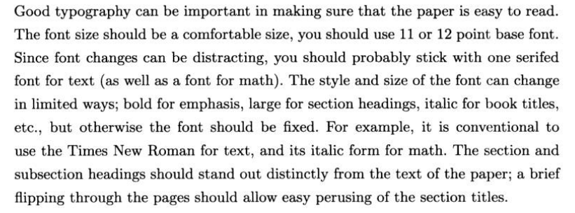
Typography

Slide 92
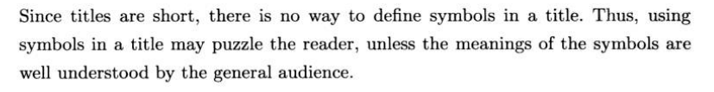
Avoid using Symbols in Titles

Slide 93
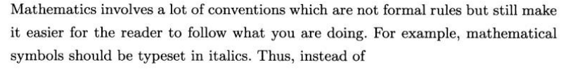
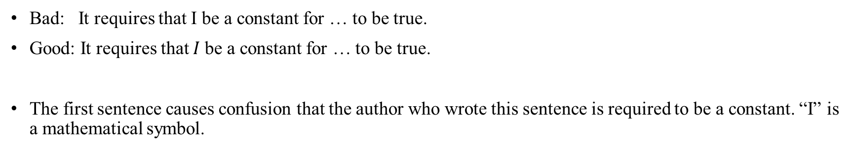
Stick with Notational and Typographical Conventions
Bad: It requires that I be a constant for … to be true.
Good: It requires that $I$be a constant for … to be true.
The first sentence causes confusion that the author who wrote this sentence is required to be a constant. “I” is a mathematical symbol.

Slide 94
Do not Reuse Symbols
Each symbol in a paper should be used for only one purpose.
Define the symbol first before you use it.
Let x be a random variable that follows the formal distribution.

Slide 95
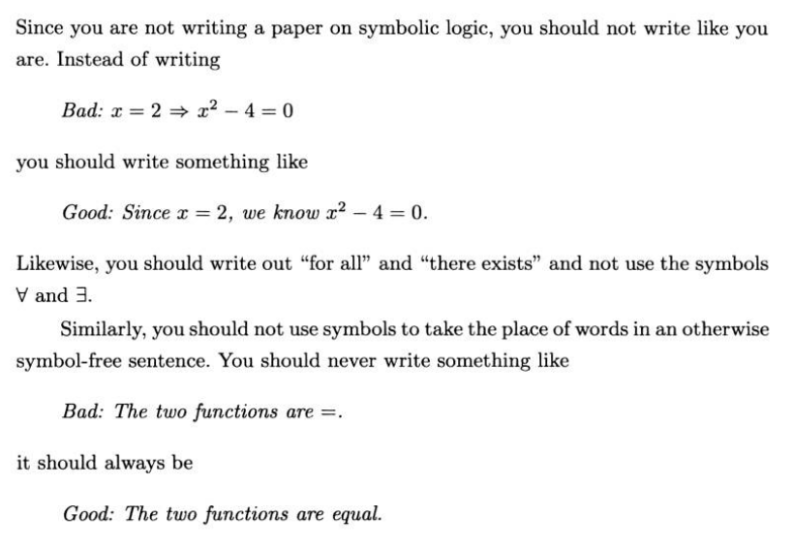
Do not Use Symbols for Words

Slide 96
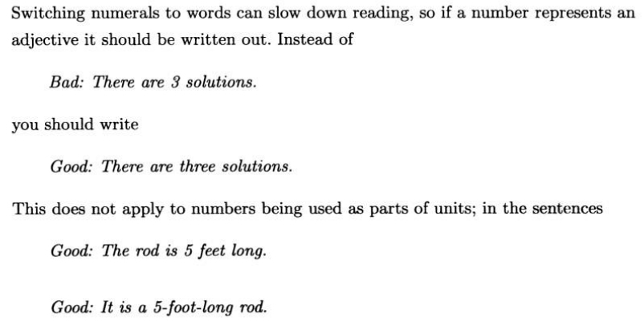
Spell out numbers that are used as adjective

Slide 97
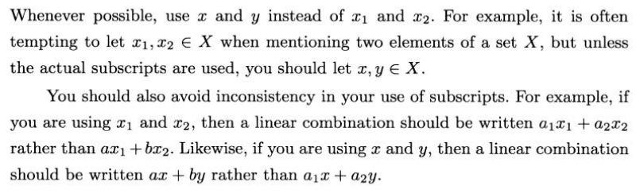
Avoid Unnecessary Subscripts

Slide 98
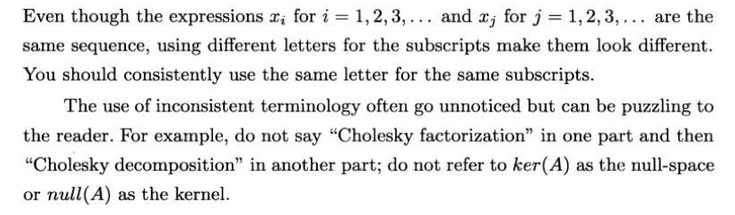
Consistent with your Natation and Terminology

Slide 99
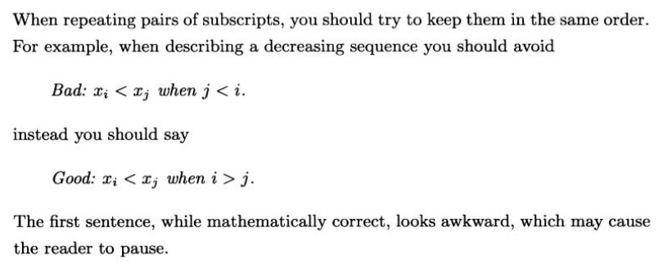
Keep Subscripts in the Same Order

Slide 100
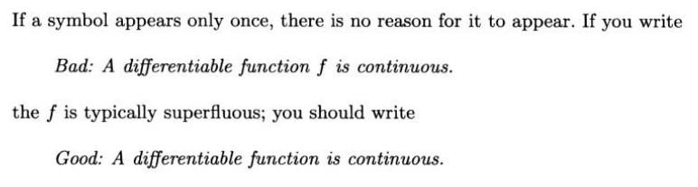
Remove symbols that are used only once

Slide 101
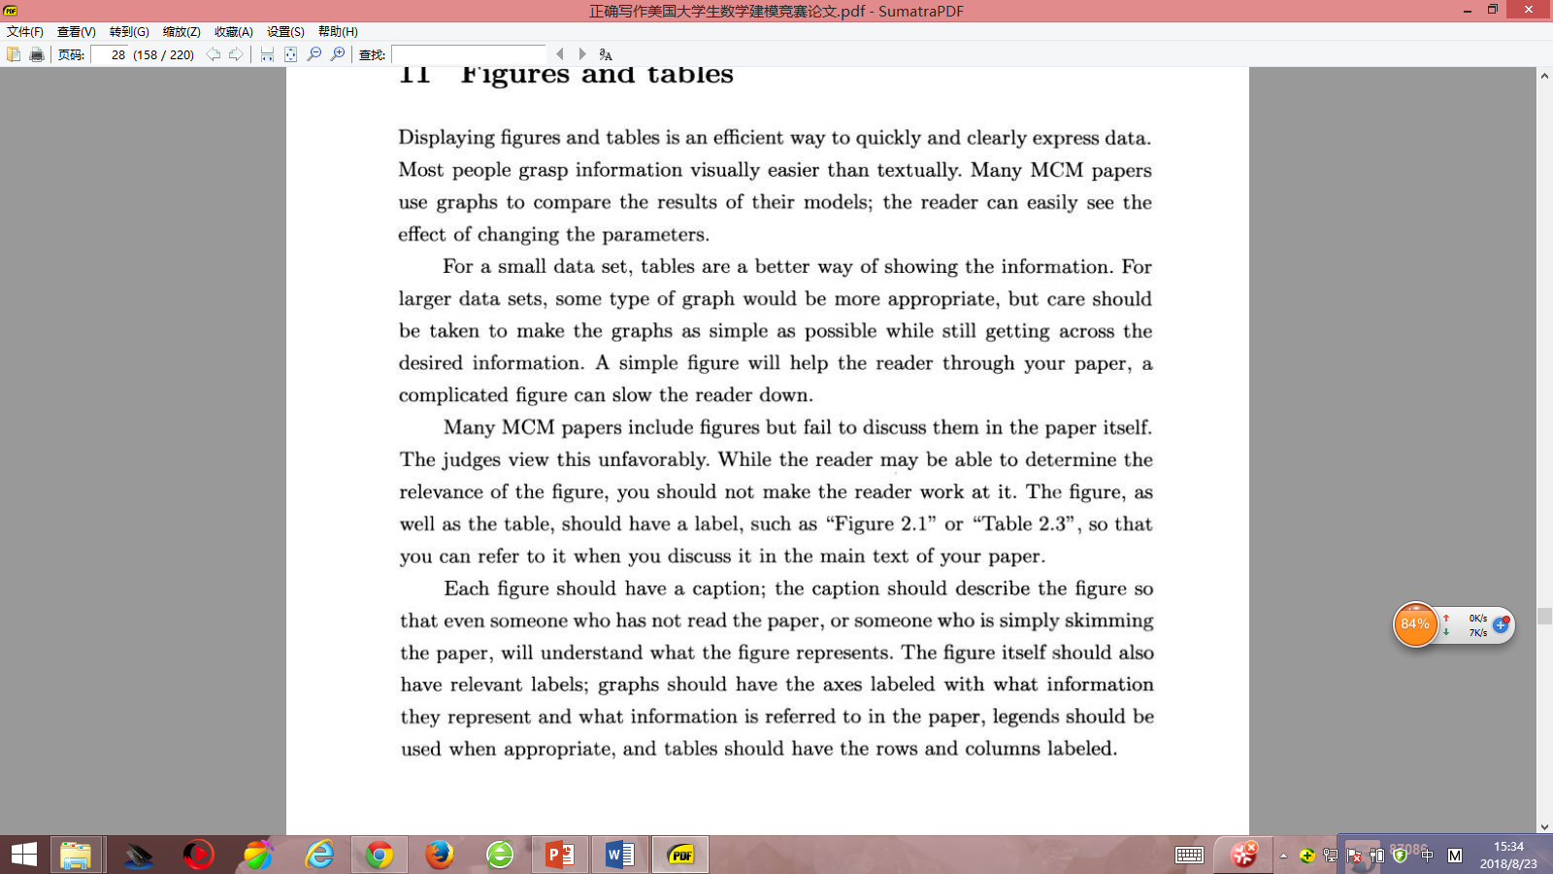
Figures and Tables

Slide 102
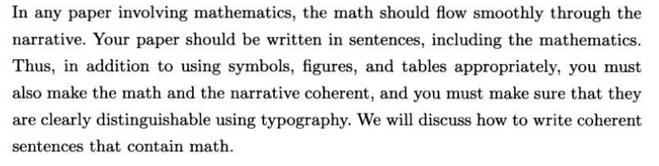
Math and Sentences

Slide 103
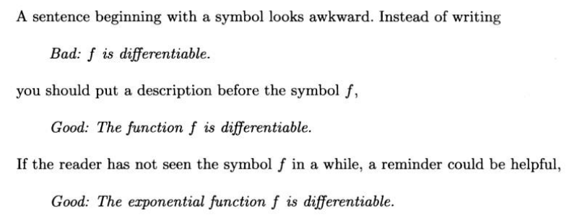
Do not begin a sentence with a symbol

Slide 104
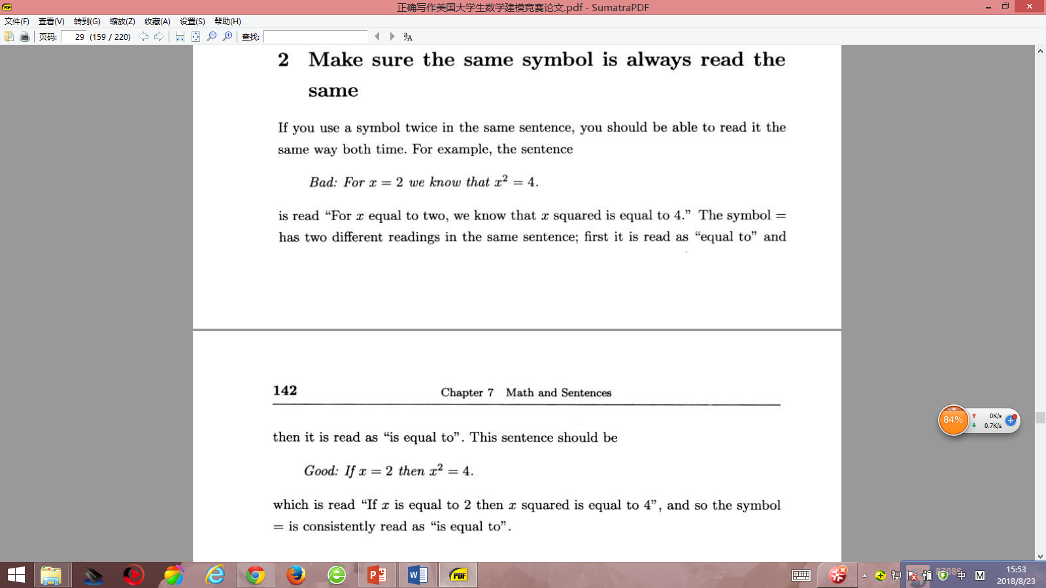
Make sure the same symbol is always read the same

Slide 105
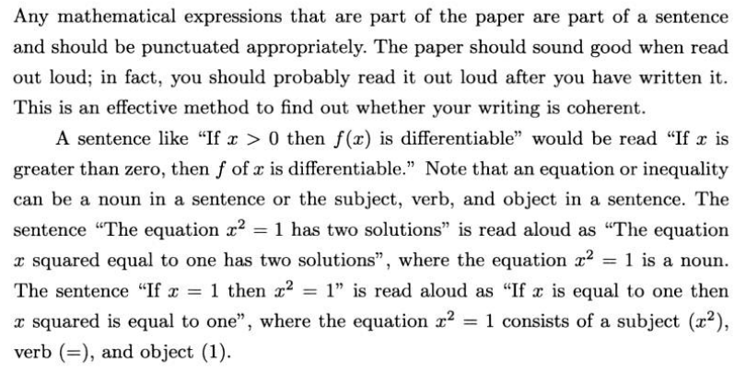
Punctuation and coherence

Slide 106
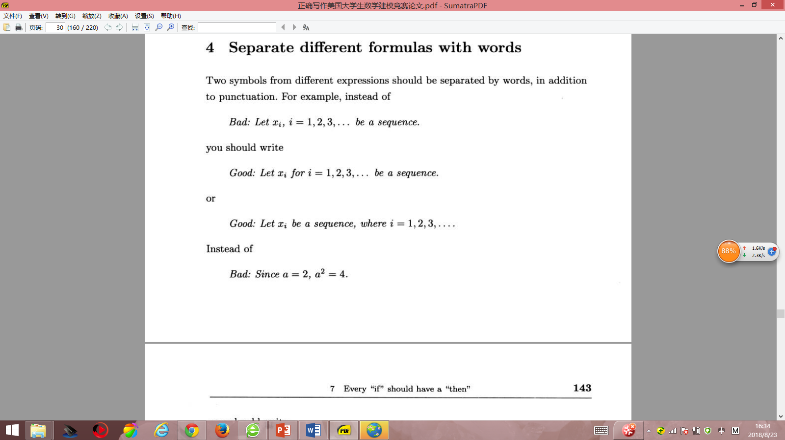
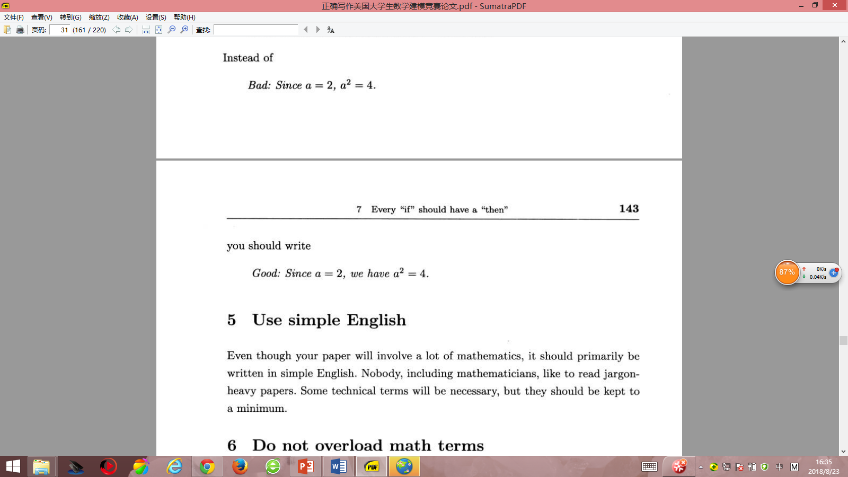
Separate different formulas with words

Slide 107
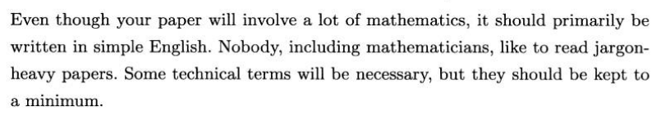
Use simple English

Slide 108

Do not overload math terms

Slide 109
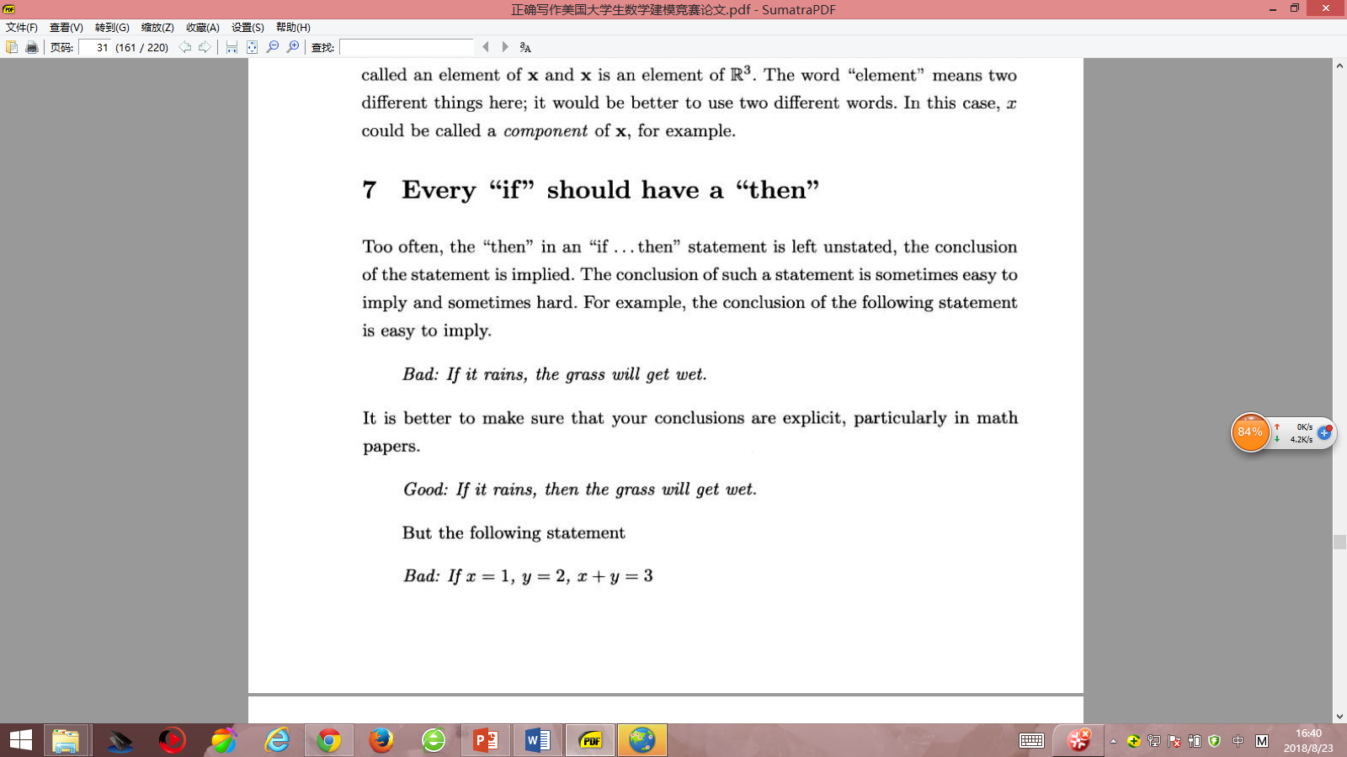
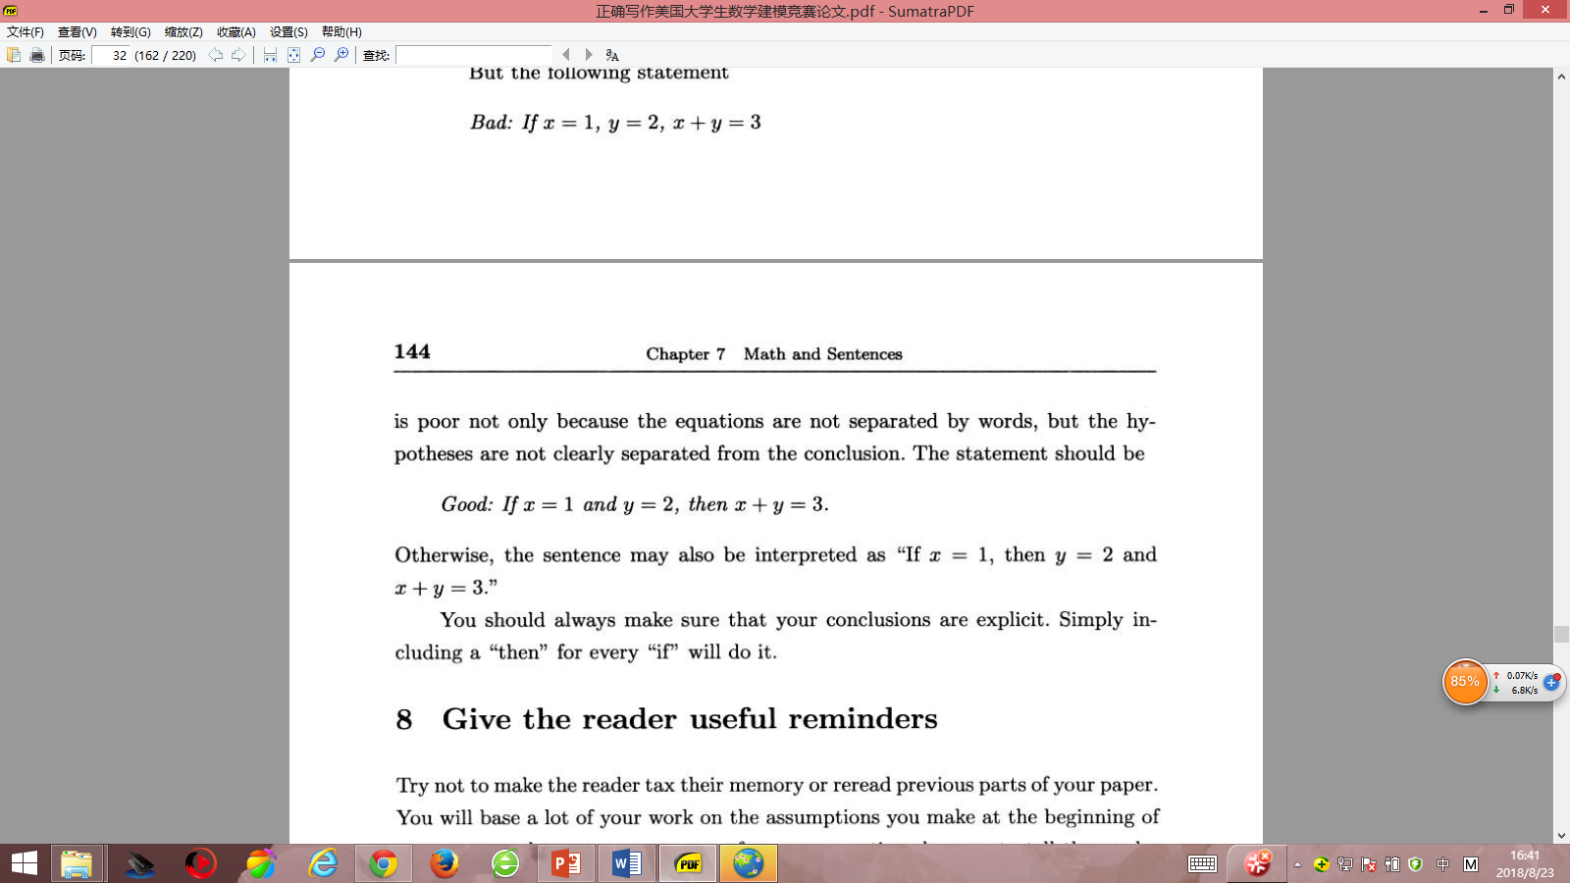
Every “if” should have a “then”

Slide 110
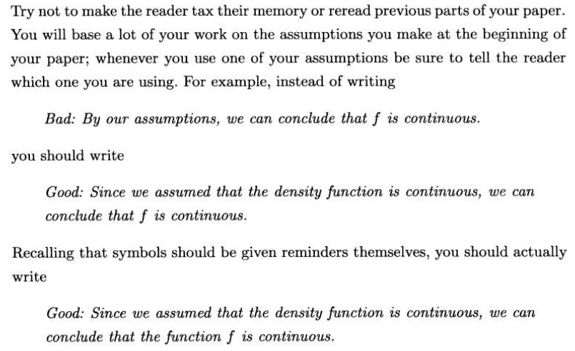
Give the reader useful reminders

Slide 111
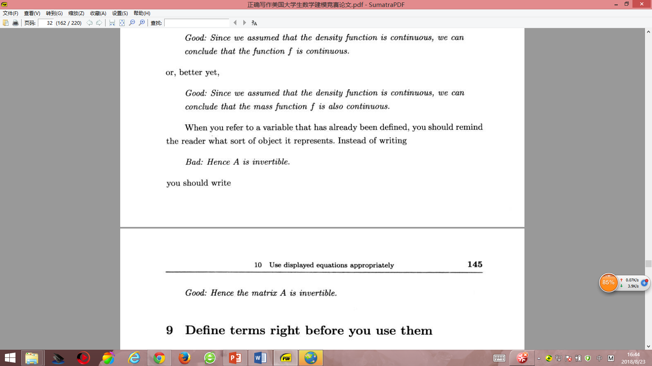
Give the reader useful reminders

Slide 112
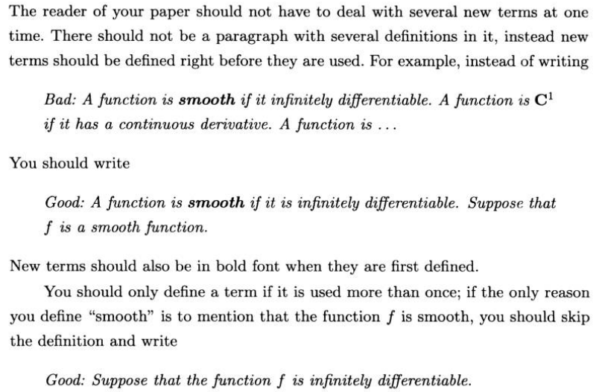
Define terms right before you use them

Slide 113
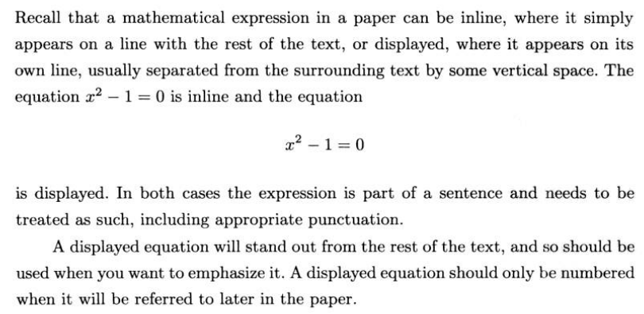
Use displayed equations appropriately

Slide 114
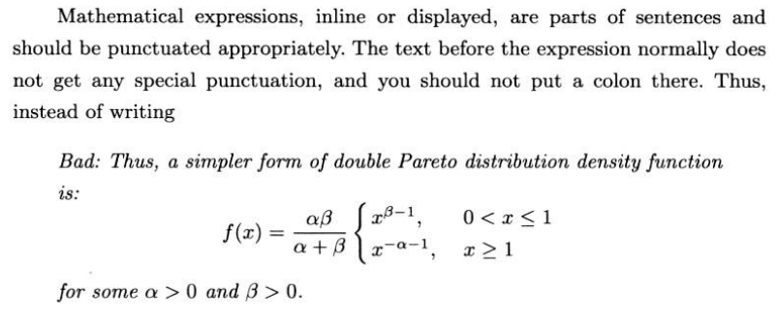
Use displayed equations appropriately

Slide 115
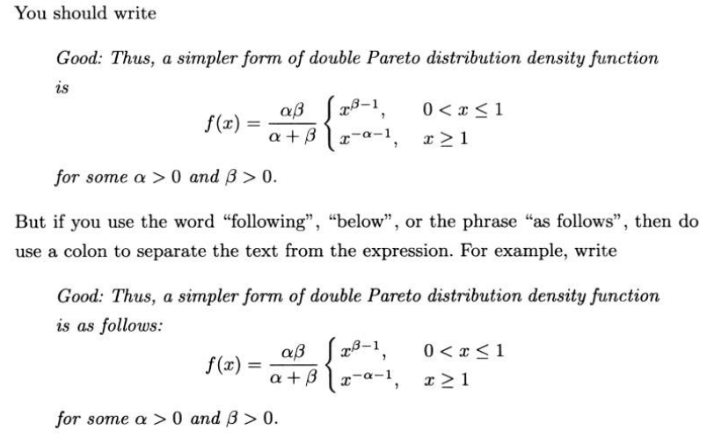
Use displayed equations appropriately

Slide 116
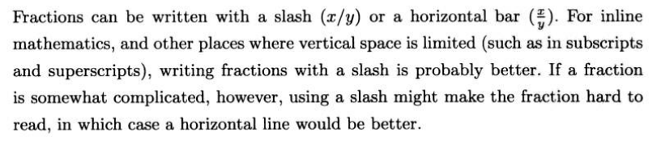
Make your fractions readable

Slide 117
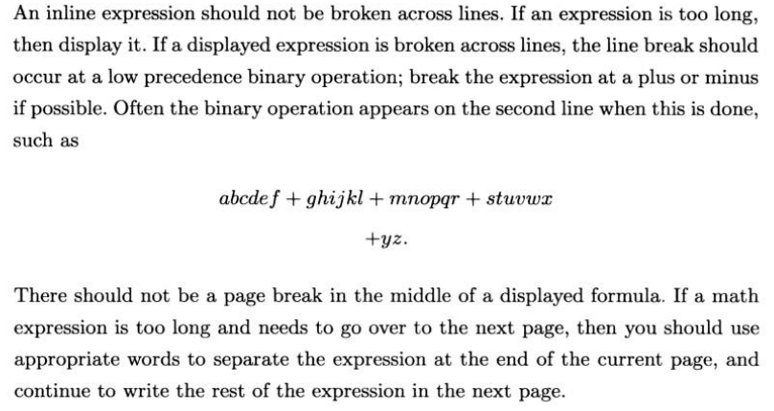
Watch your breaks and alignment in expressions

Slide 118
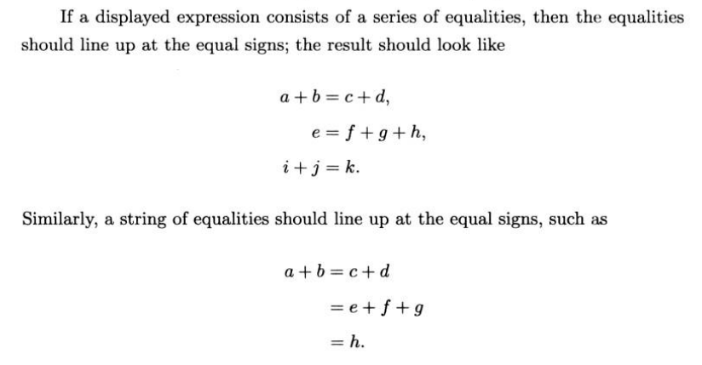
Watch your breaks and alignment in expressions

Slide 119
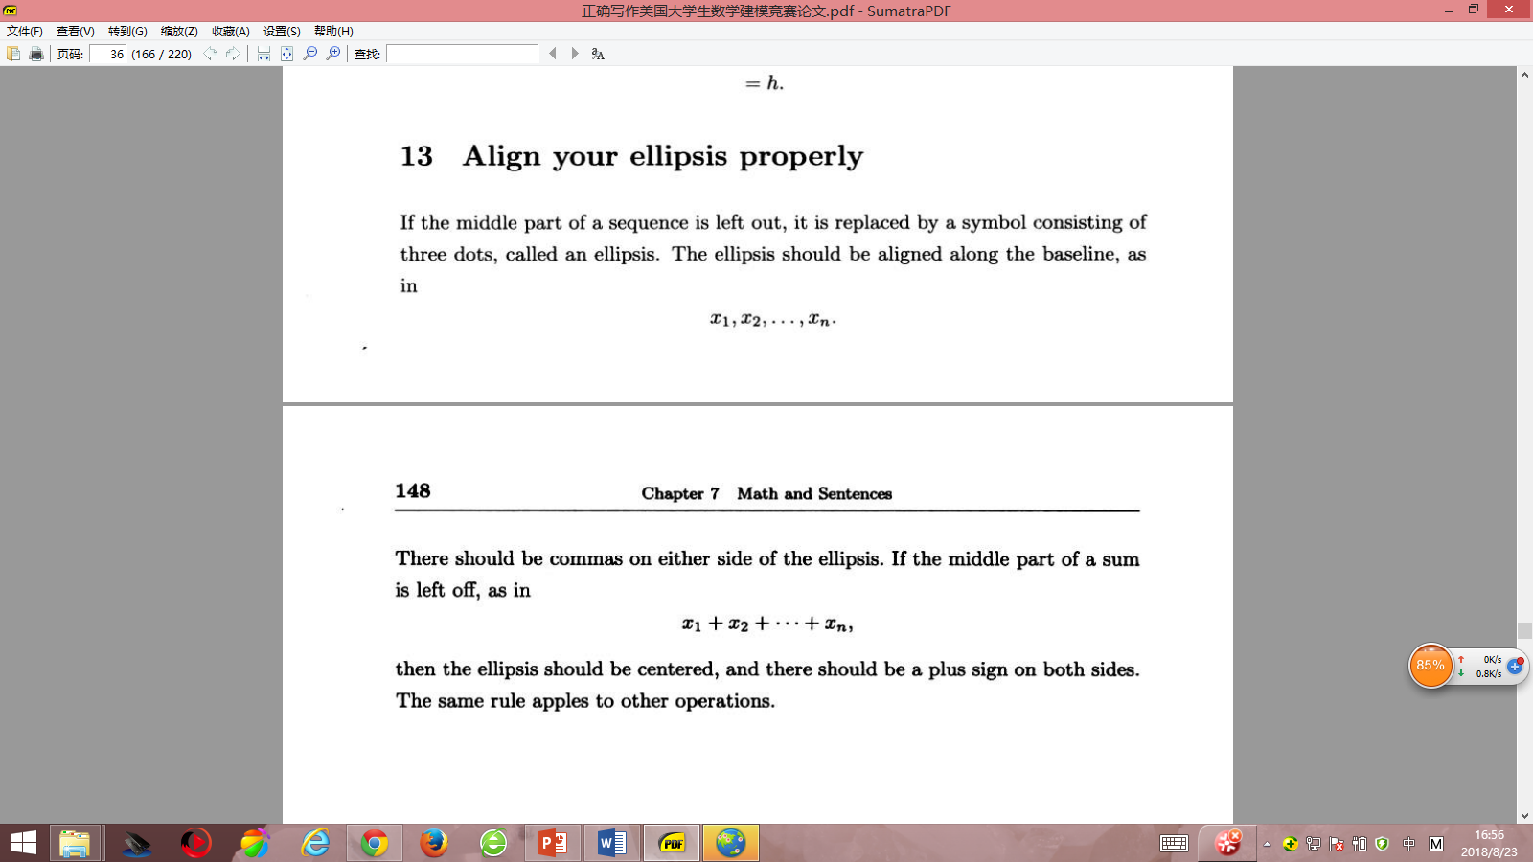
Align your ellipsis properly

Slide 120
Expressing Caution

Slide 121
Expressing Caution
One feature that makes academic writing different from other forms of communication is the need to take care over the degree of certainty or uncertainty you express. This applies particularly when you are making claims on the basis of what you have read in the sources you are citing, and when you are interpreting research findings.
In discussion we may make stronger, more definite statements without being challenged,
but in academic writing, we have to adjust the strength of claim to match the evidence we have cited.
This expression of academic caution is known as hedging.

Slide 122
Various words are used to describe this feature of academic language.
The hedged claims being said
‘tentative’, ‘limited’, ‘moderate’ or ‘modest’.
claims that are stronger than is justified by the evidence are said to be
‘overstated’, ‘exaggerated’, or ‘immoderate’.
The cases where a writer has provided no support at all would be criticized as
‘unfounded’ or ‘unwarranted’ claims.

Slide 123
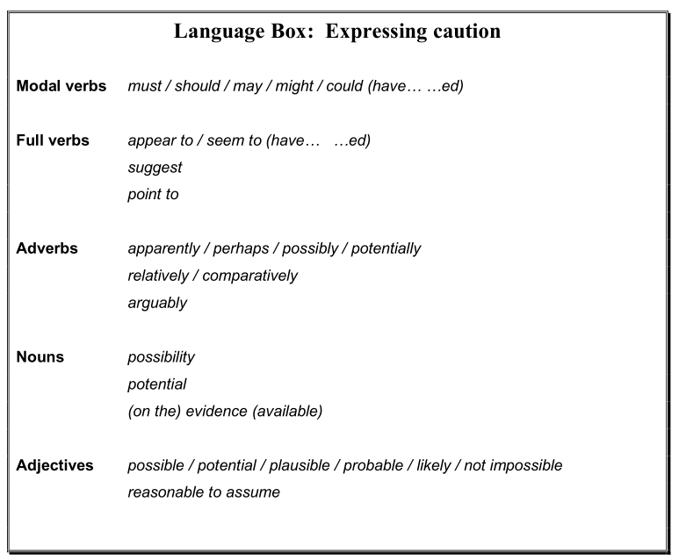
Words used to express caution

Slide 124
Caution in interpreting others’ research
In most academic fields, research students are asked to interpret findings of published work. You need to choose words carefully, in order to express the appropriate degree of caution in your interpretation.

Slide 125
Task 1
The extract below comes from a study investigating how British students who speak Spanish as a second language (L2) are influenced as they learn Portuguese as a third language (L3).
Underline the definite expressions and circle the cautious ones.

Slide 126
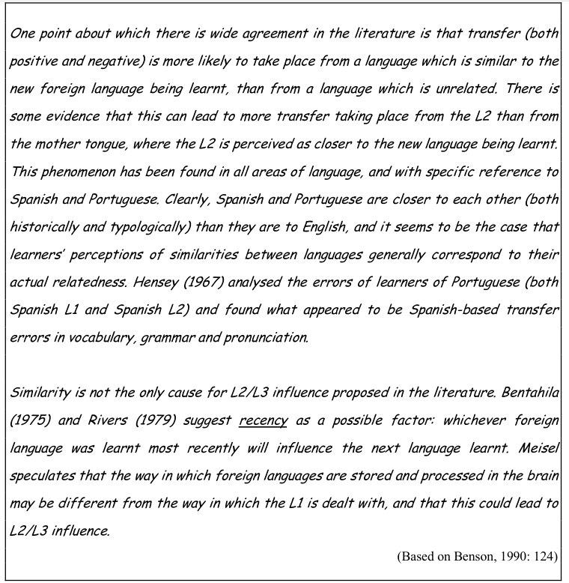

Slide 127
Task 2
Is the student (Benson) expressing her own opinion of the research findings,
or
is she reporting the caution of the original authors?

Slide 128
Caution in interpreting your own findings
If an assignment requires you to report and analyze the results or data from your own research, it is important that you choose the appropriate level of certainty when interpreting what you have found.

Slide 129
Task 3
This comes from a recent research paper in which the authors reported the findings of a survey on attitudes to learning English in two groups of students in Edinburgh – one from Hong Kong and the other from Japan.
Underline the words (full verbs, modal verbs, adjectives, etc.) used to moderate or strengthen the interpretation.

Slide 130
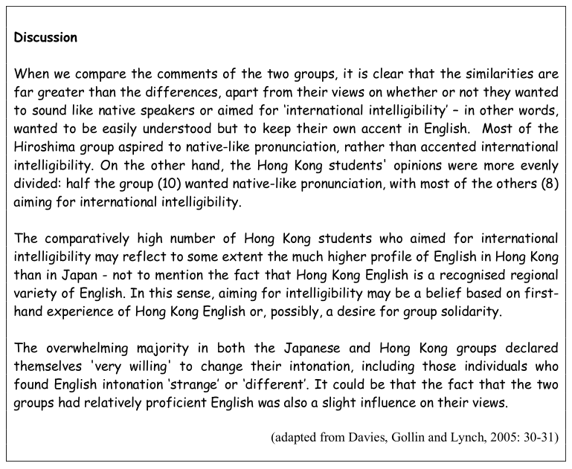

Slide 131
Task 4
Below are two paragraphs from the sample Internet essay that we asked to read at the end of Unit 2. (The whole essay is on pages 22-25 of your Supplementary Materials).
In some places the student has not been cautious enough in making points and claims about Internet use. For example, a sentence such as “Everyone has access to the Internet at home” would clearly be an exaggeration.
Look for points that you think are not cautious enough (e.g. overgeneralisations) or too cautious. Decide how to make them more, or less, cautious. Edit the text at those points to include your changes.

Slide 132
Text (Part one)
First of all, the Internet is always a good place to get started. Writing an essay is often a painstaking task and sometimes you will even get stuck in choosing an appropriate topic. If it is really a problem, using a search engine by typing in several simple keywords about the topics in mind will give you some rough pictures. It is rather like a “brainstorm” that you will find thousands of opinions and ideas for a single topic, which may reflect how “hot” the topic is, how many people have similar idea with you and how much resources on Web you can make use of. Through comparison, you will find how valuable a topic is or is not.

Slide 133
Text (Part two)
When a topic is selected, the next step is to seek professional help and turn to electronic resources such as e-journals and e-periodicals for reference. Reading on computer perhaps not quite comfortable, but as a tradeoff, you can make marks on these e-books while doing this will never be permissible on print in the library. Moreover, as more and more researchers begin to use Internet resources, you will find a lot of articles on journals and periodicals have Internet hyperlinks as reference in their bibliographic, those you can turn to by just mouse clicks. To make the full use of the Internet, you can also exchange ideas with the author or ask questions via email. In a word, the Internet provides everything you need in reading, not only the reading materials, but also other convenience like the search engines, electronic dictionaries, communication tools and quick access towards other materials.

Slide 134
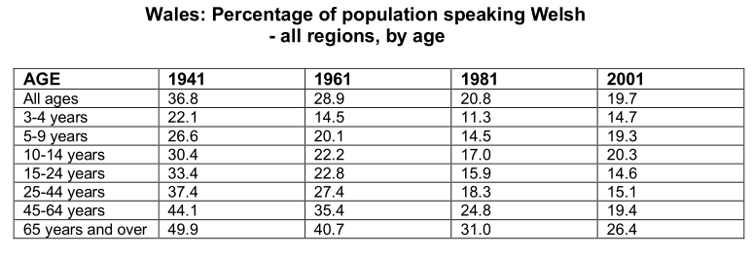
Caution in interpreting data

Slide 135
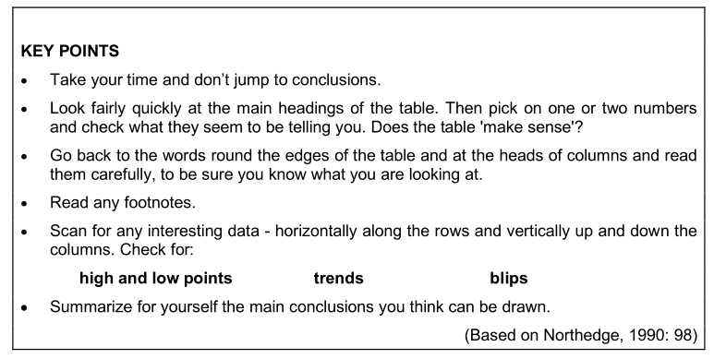
Caution in interpreting data

Slide 136
Task 5
The previous table shows the percentage of Welsh speakers in Wales over a 60-year period.
Decide what conclusions you can draw about life and education in Wales, on the basis of this evidence.
Use Northedge’s guidelines and the Language Boxes to help you express the right level of caution.
Write out your interpretations as full sentences.

Slide 137
Phrase
Adverbial phrase
A phrase that functions as an adverb. Examples:
She types quickly and correctly.
He runs extremely fast
Gerundial phrase
Going to public concerts is often free of charge
Prepositional phrase
by accident, on account of, in addition, in addition to, on the basis of, at (the) best, for the better, on board, out of breath, on business, in any case, in case of, in case, in no case
Participial phrase
Following this road, you will find the bus stop.
Do you know the girl making paper flowers?
Walking along the street, he saw a bar.

